Slide 1

REBEL
STARTER PACK
Oct 2019
We are facing an unprecedented global emergency. The government has failed to protect us. To survive, it’s going to take everything we’ve got.
This document provides a brief introduction to Extinction Rebellion, along with links to more detailed information about the movement and suggestions for how you can get involved.

Slide 2
WHAT IS EXTINCTION REBELLION?
Extinction Rebellion is an international movement that uses nonviolent civil disobedience in an attempt to halt mass extinction and minimise the risk of social collapse.

Slide 3
On 31st October 2018, British activists assembled on Parliament Square in London to announce a Declaration of Rebellion against the UK Government. The next few weeks were a whirlwind. Six thousand rebels converged on London to peacefully block five major bridges across the Thames. Trees were planted in the middle of Parliament Square, and a hole was dug there to bury a coffin representing our future. Rebels super-glued themselves to the gates of Buckingham Palace as they read a letter to the Queen.
Extinction Rebellion was born.
The call to rebel swiftly became global, with branches popping up the following week in Europe, the US, and soon after the world over.
Leaderless and truly global, each new branch makes the movement stronger, bringing in new perspectives, wisdom, expertise, energy and inspiration.

Slide 4
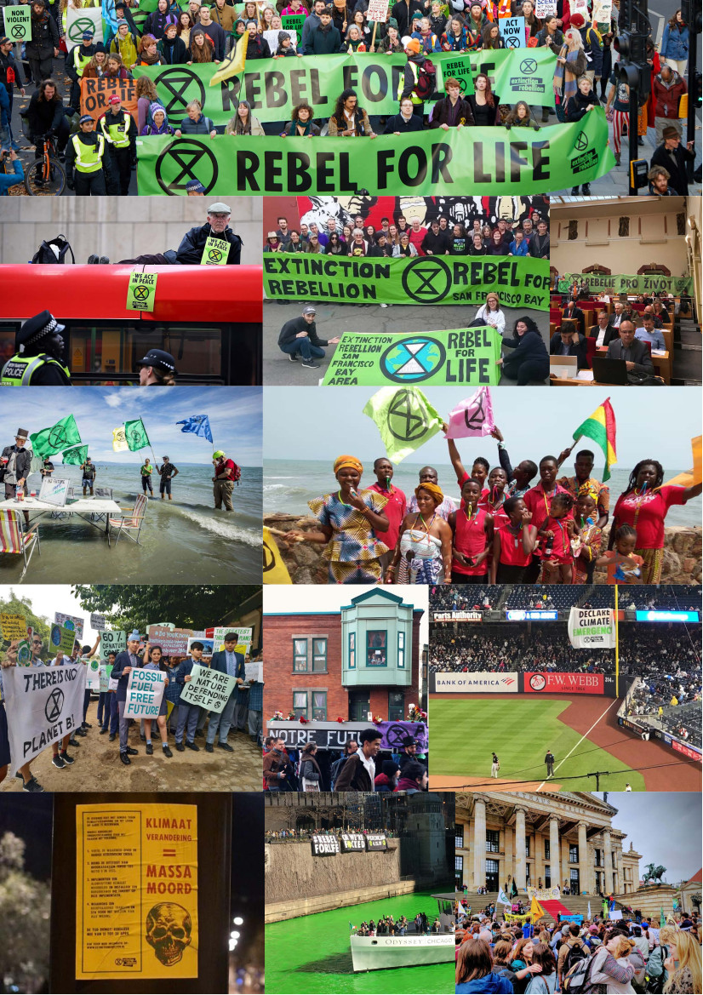
On 15th April 2019, we declared the Emergency, taking direct action on the streets in cities across the world from Auckland to Accra, Mexico City to Vancouver. In October 2019, the rebellion grew even more, with actions happening in over 60 different countries all over the globe.
We are now active in over 70 countries with nearly 500 local groups working relentlessly to build our movement.
So what is next?
None of our demands have been met. So now, we must confront the elites who profit massively from driving us all headlong towards extinction.
Extinction Rebellion groups from across the world will continue gather in key cities to rebel.
It’s going to be huge.
Come and join us. Rebel for life. For the planet. For our children’s futures. There is so much work to be done!

Slide 5
WHY DO WE NEED TO REBEL?
We will not be led quietly to extinction by the elites and politicians. Conventional campaigning has failed. Carbon emissions have increased by 60% since scientists first warned of ecological collapse in 1990.
We will work together with love, compassion, honour, resilience, and peace, using nonviolent civil disobedience in the spirit of all those who fought for our freedoms before us.
We call on every one of you, regardless of your political beliefs, to join us in fighting for the survival of life on earth.
Watch our Heading for Extinction talk.

Slide 6
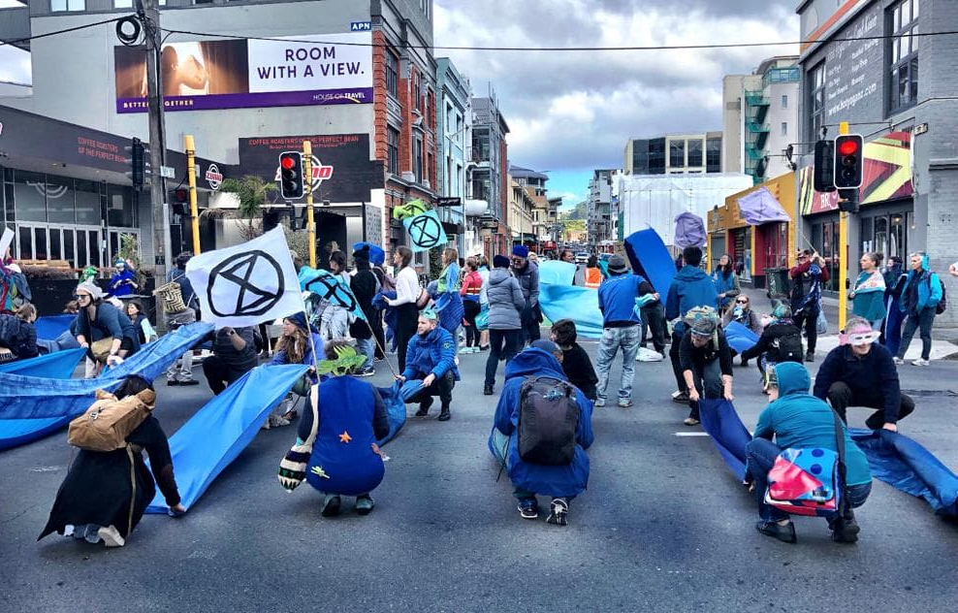
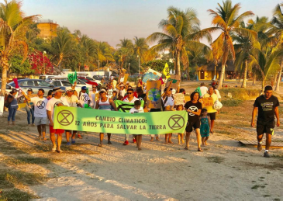
The XR Theory of Change is based on social science which shows that we need to generate pressure for change using momentum-driven organising to build a decentralised, resilient, mass movement which is non violent, disruptive, self-sacrificial and respectful.
We need global change towards a new social and economic paradigm based on sufficiency and respect for our interdependence with the natural world.
To build a decentralised, resilient, mass movement which is non violent, disruptive, self-sacrificial and respectful.
Support the transformation of individuals and communities through support networks, grief work, connection fostering, self-organisation and deliberative democracy.

Slide 7
94 academics supporting the UK Declaration of Rebellion signed an Open Letter to The Guardian saying:
“We will not tolerate the failure of this or any other government to take robust and emergency action in respect of the worsening ecological crisis. The science is clear, the facts are incontrovertible, and it is unconscionable to us that our children and grandchildren should have to bear the terrifying brunt of an unprecedented disaster of our own making.
We are in the midst of the sixth mass extinction, with about 200 species becoming extinct each day. Humans cannot continue to violate the fundamental laws of nature or of science with impunity. If we continue on our current path, the future for our species is bleak.
Our government is complicit in ignoring the precautionary principle, and in failing to acknowledge that infinite economic growth on a planet with finite resources is non-viable. Instead, the government irresponsibly promotes rampant consumerism and free-market fundamentalism, and allows greenhouse gas emissions to rise.”
This was followed by a Second Open Letter signed by (among others): Dr Vandana Shiva, Naomi Klein, Noam Chomsky, Prof AC Grayling, Philip Pullman, Dr Rowan Williams, and Bill McKibben.

Slide 8
WHAT DO WE WANT TO ACHIEVE?
We have three demands:
TELL THE TRUTH
Government must tell the truth by declaring a climate and ecological emergency, working with other institutions to communicate the urgency for change.
ACT NOW
Government must act now to halt biodiversity loss and reduce greenhouse gas emissions to net zero by 2025.
BEYOND POLITICS
Government must create and be led by the decisions of a Citizens’ Assembly on climate and ecological justice.

Slide 9
This is an Emergency and we will do what we believe to be necessary.
We are completely nonviolent, our actions are done in full public view and we take responsibility for them. Here is an example of an Action Consensus from the UK, which outlines how we can work together on actions.
We are about political change, not personal change (though we welcome the latter).
Follow up questions:
What would it mean for the Government to tell the truth?
Is it possible to reduce carbon emissions to net zero?
What is a Citizens’ Assembly?

Slide 10
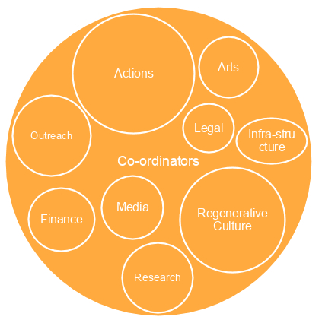
HOW DO WE ORGANISE?
We organise in small groups. These groups are connected in a complex web that is constantly evolving as we grow and learn.
We are working to build a movement that is participatory, decentralised, and inclusive.
The structure aims to empower anybody to act as part of XR, so long as they agree to follow our ten core principles. You can check out the Self-Organising System for more information on how groups might be structured. We are seeking a balance between being able to act quickly in response to fast-changing situations and being able to integrate the collective wisdom of multiple perspectives when needed.
There are nearly 500 local, regional and national groups across the world, each of which is building its own structures with different working groups.
This Ways of Working document might also help rebels when they’re starting up.
Here is an example of a working group structure that some countries are using. It’s not an exhaustive list. Some groups here may be national, some may be local:

Slide 11
OUR PRINCIPLES & VALUES
Any person or group can organise autonomously and take action in the name and spirit of XR so long as the action fits within XR’s principles and values. In this way, power is decentralised, meaning that there is no need to ask for permission from a central group or authority.
1. We have a shared vision of change creating a world that is fit for the next 7 generations to live in.
2. We set our mission on what is necessary mobilising 3.5% of the population to achieve system change – such as “momentum-driven organising” to achieve this.
3. We need a regenerative culture creating a culture which is healthy, resilient and adaptable.
4. We openly challenge ourselves and this toxic system leaving our comfort zones to take action for change.
5. We value reflecting and learning following a cycle of action, reflection, learning, and planning for more action. Learning from other movements and contexts as well as our own experiences.
6.We welcome everyone and every part of everyone working actively to create safer and more accessible spaces.
7. We actively mitigate for power breaking down hierarchies of power for more equitable participation.
8. We avoid blaming and shaming we live in a toxic system, but no one individual is to blame.
9. We are a nonviolent network using nonviolent strategy and tactics as the most effective way to bring about change.
10.We are based on autonomy and decentralisation we collectively create the structures we need to challenge power. Anyone who follows these core principles and values can take action in our name.

Slide 12
HOW CAN YOU GET INVOLVED?
PARTICIPATE IN THE REBELLION
In October 2019 there were mass blockades, people’s assemblies, workshops and much more happening all over the world. From New Zealand, to Argentina, South Africa to France, people came together to create change. Contact your local group to find out what they are planning in the coming months.
VOLUNTEER IN A KEY ORGANISING ROLE
Every group needs skilled and committed volunteers to take on key organising roles in preparation for the October rebellion in multiple countries beginning 7th October. These roles require regular time commitment for most of October: full-time, part-time, or one full working day a week as part of a job share. If you would like to take on one of these responsibilities, please contact your local group, details can be found on the map on the international website. If you can’t find your group there, or would like support in setting one up, then drop us a message here.
LEARN MORE ABOUT EXTINCTION REBELLION
Watch our Heading for Extinction talk online, or find an event in your country.
You can also find us on Social Media: Facebook, Instagram, YouTube.
JOIN YOUR LOCAL XR GROUP
Help build our grassroots movement by spreading the XR message in your community. Join an affinity group, organise in local working group, and attend training sessions to prepare for the international rebellion. Here is a map of groups across the world.

Slide 13
DO YOU COMMIT TO NONVIOLENCE?
ARE YOU ALIGNED WITH OUR PRINCIPLES AND AIMS?
IF SO YOU ARE EXTINCTION REBELLION AND YOU CAN ACT
IN OUR NAME.
More questions? Know the facts

